Slide 1


AUTOMATED WEBSCRAPER PRESENTATION
By-NICOLE MASCARENHAS DIVYAL PATIL
AKSHAT SARRAF
UNDER MENTORSHIP OF: SARIKA DAVARE

Slide 2

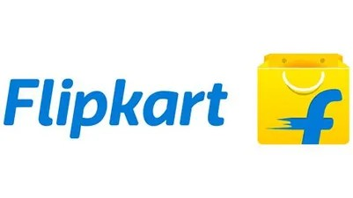


PROBLEM STATEMENT:
To Detect and automate the process of extraction from given links of websites (Amazon,Flipkart, Myntra,...etc.). component for (B2B) Data Delivery service.

Slide 3

OBJECTIVES:
Site Detection
Data Extraction
Data Transformation
Process automation

Slide 4

SCOPE:
Detection and automation of the process of web scraping of given website.
Extraction which is usually based on client's requirements is variable, we push the boundaries of certainty of extraction with little to no human intervention.

Slide 5


EXISTING SYSTEM:
Amazon Scrapy Web Extractor is a web scraping tool that extracts product details, ratings, prices, images and more from Amazon websites. It is easy to use and provides fast and reliable data extraction.

Slide 6

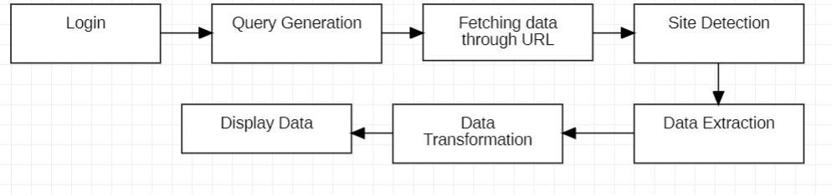

BLOCK DIAGRAM:

Slide 7



SOFTWARE & HARDWARE REQUIREMENT:
Language - PYTHON , DJANGO Libraries - Beautiful Soup, Requests,
Numpy, Pandas Web Driver - Selenium
Web Browser - Brave, Chrome

Slide 8
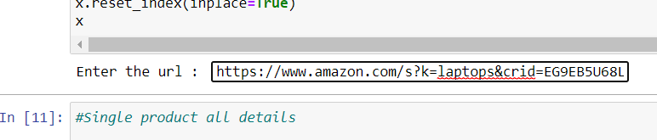
IMPLEMENTATION :
1. Paste website URL:
The first step in the process is for the person to paste the website URL that contains the data they need.

Slide 9

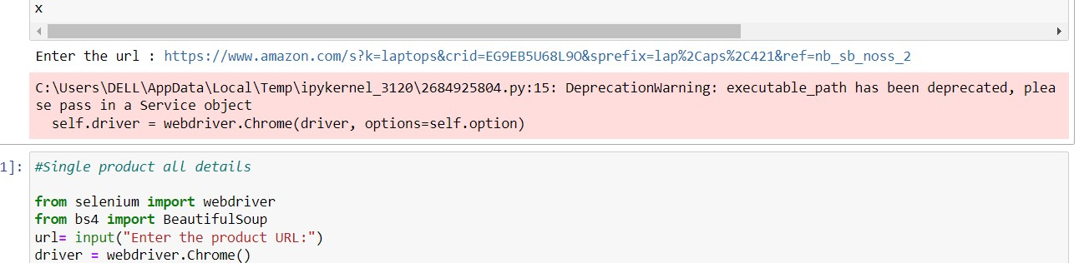
2. Automation: The process of obtaining the required data is automated, which enables the person to get
the data quickly and efficiently.

Slide 10
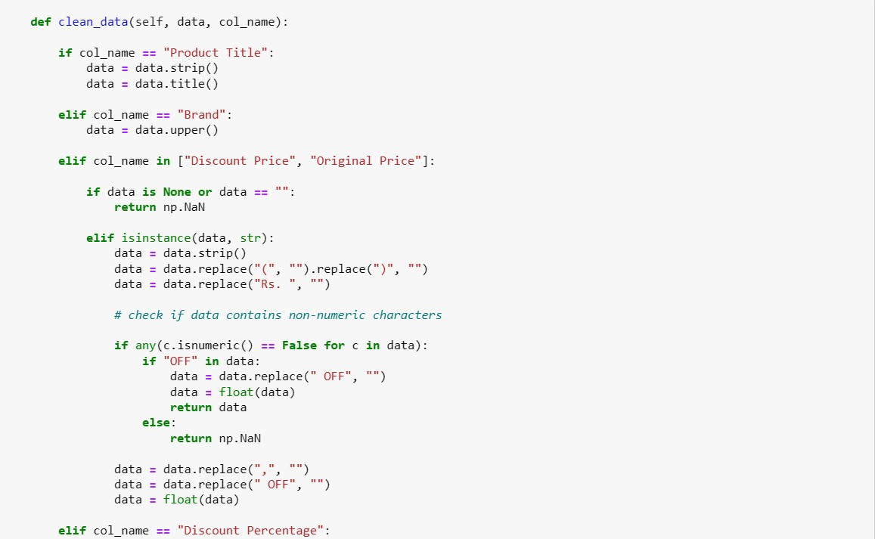
3. Data Cleaning: The data will be cleaned using pandas which involves identifying and correcting errors in the
data to improve its quality and reliability for further analysis.

Slide 11
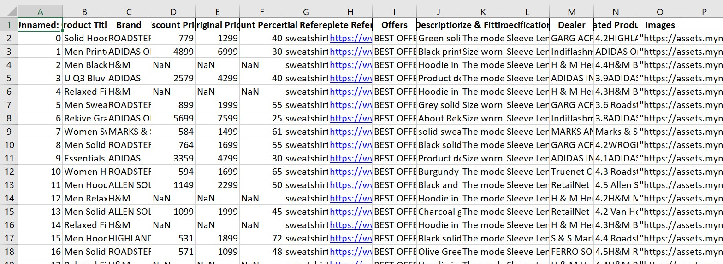
4. Proper Formatting: The data will be provided in a properly formatted and compiled way, making it easier for the person to
analyse the data.

Slide 12
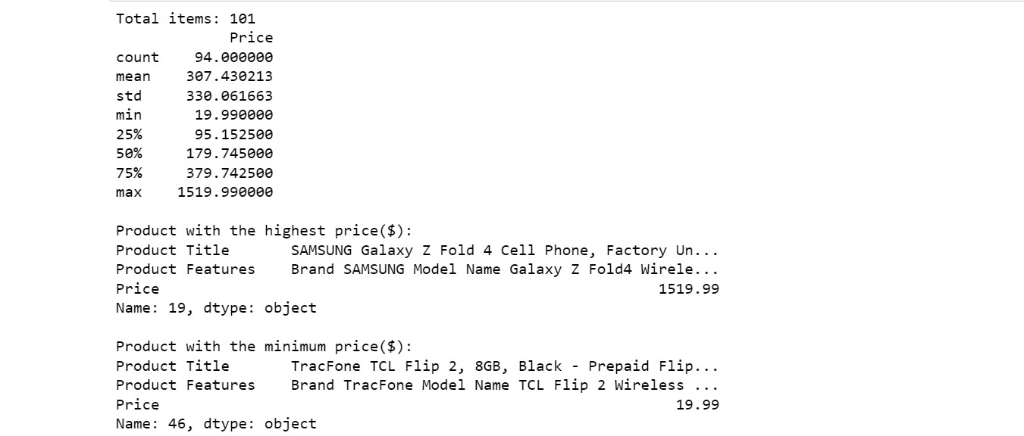
4. Summary Report:

Slide 13
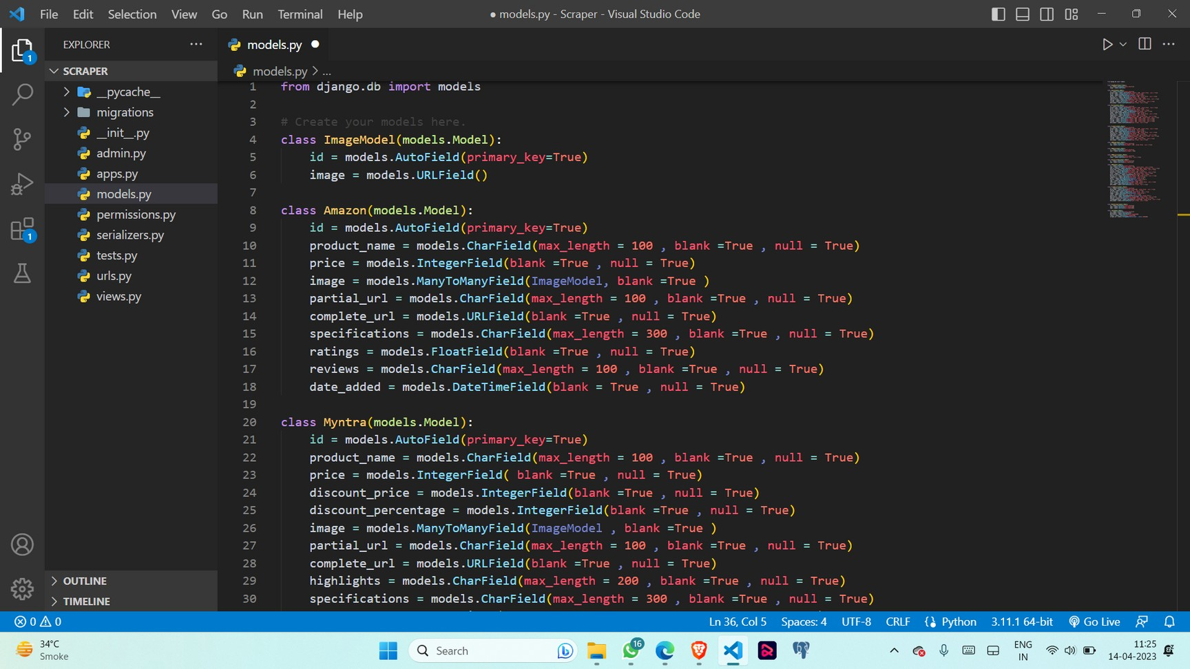
5. Models

Slide 14
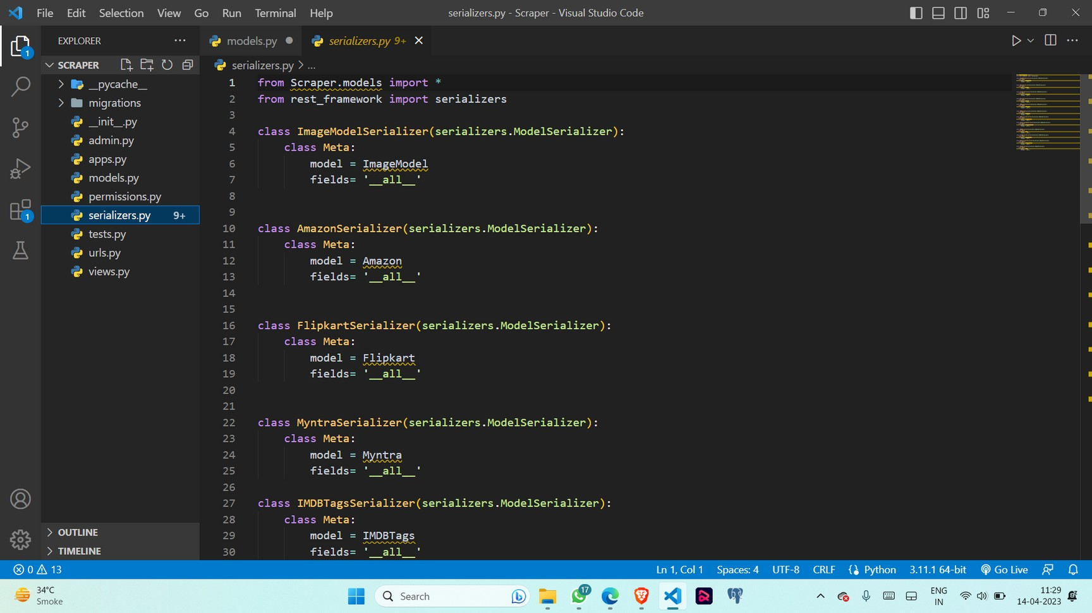
6. Serializers

Slide 15
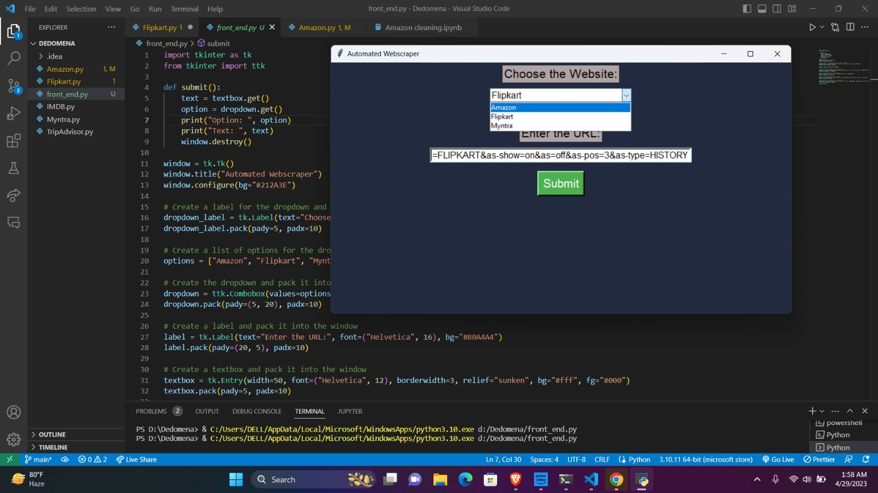
7. GUI

Slide 16
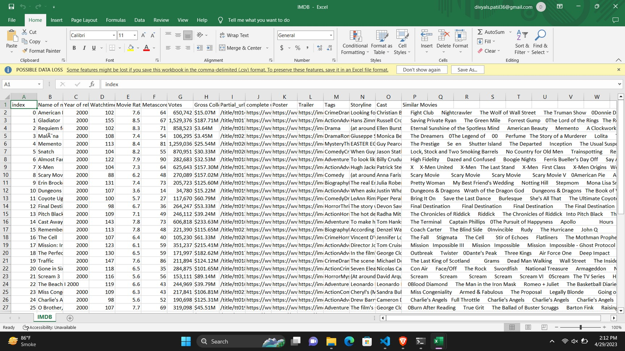
8. OUTPUT

Slide 17

ADVANTAGES :
Complete Automation
Time Efficient
Cost Efficiency
Track product performance
Data Accuracy

Slide 18

APPLICATIONS :
·Finding opportunities for investment
·Gathering web data automatically
·Researching new concepts in a field
·Monitoring news sources
·Generating sales leads

Slide 19


CONCLUSION :
By leveraging web scraping, this project will allow businesses to gain valuable insights into consumer behavior and trends, providing them with the necessary data to make informed decisions and remain competitive.

Slide 20

THANK YOU !!!

